Slide 1
Software Engineering Introduction
CSCI 5828: Foundations of Software Engineering
Lecture 06

Slide 2
Agenda
Product background
Goals
Product
Business
Non-goals
Risks
Actors/activities
Stories
Estimation and prioritization

Slide 3
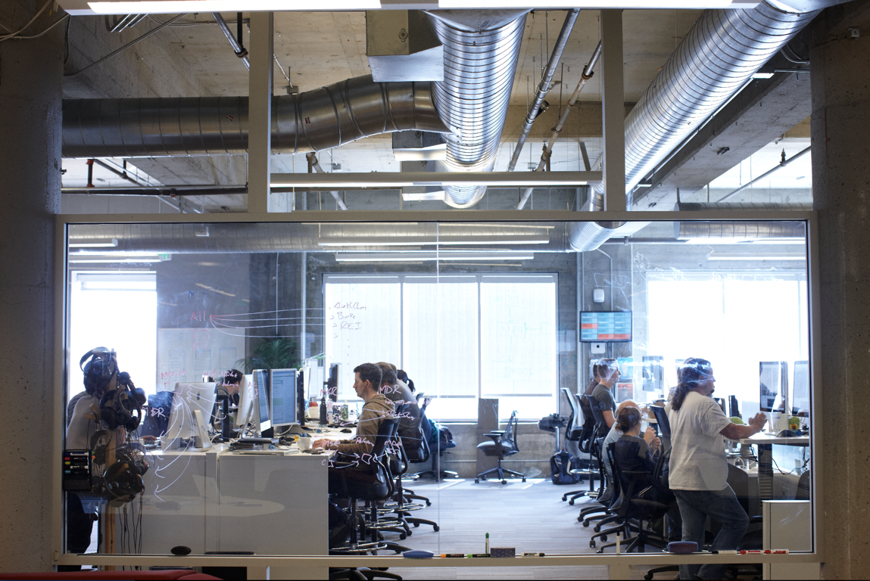
GOALS

Slide 4
What does success look like?
Financial success; you’re making money, you’re saving money
Adoption; people and/or systems are using your software
How do we ensure we’re building the right software?
iterate and adjust quickly based on user feedback (one of many techniques)
How do you iterate quickly while adjusting to feedback?
Small list of prioritized stories - but how do you get there?

Slide 5

GOALS
What we’re building?
Goals and risks
Work that needs to get done
Prioritize backlog of small stories

Slide 6
Introduction to goals
Common goals
Business goals
Product goals
Non-goals
What does a win look like?

Slide 7
Business Goals
Example business goals
Grow revenue by 15% in one year
Reduce operational costs by 50%
10% increase in user adoption in the first 3 months
Land 3 new partnerships per quarter
Goals are typically measureable Did you achieve your goal?

Slide 8
Product Goals
Example product goals
Easy to use, easy to understand
No product training required (Gmail for example)
Support 200 concurrent users
500 millisecond response time

Slide 9
Non-Goals
Example Non-Goals
Support for multiple languages
Highly available
Highly scalable
Broad browser support
Think first release, and not building too much too early w/out feedback!

Slide 10
Why goals are important
Why should I care about goals?
Helps bring product and engineering together
One set of common goals
Meet delivery timelines
Important for engineers to understand what they’re building
So engineers are focused
So that you could better prioritize a backlog of small stories
So engineers can push back on work that may be out of scope

Slide 11
Goals Exercise
Let’s walk through a product description
As you listen add any goals that you can identify to this shared document.
+1 when you see a similar goal

Slide 12
Goals Exercise
Let’s review

Slide 13
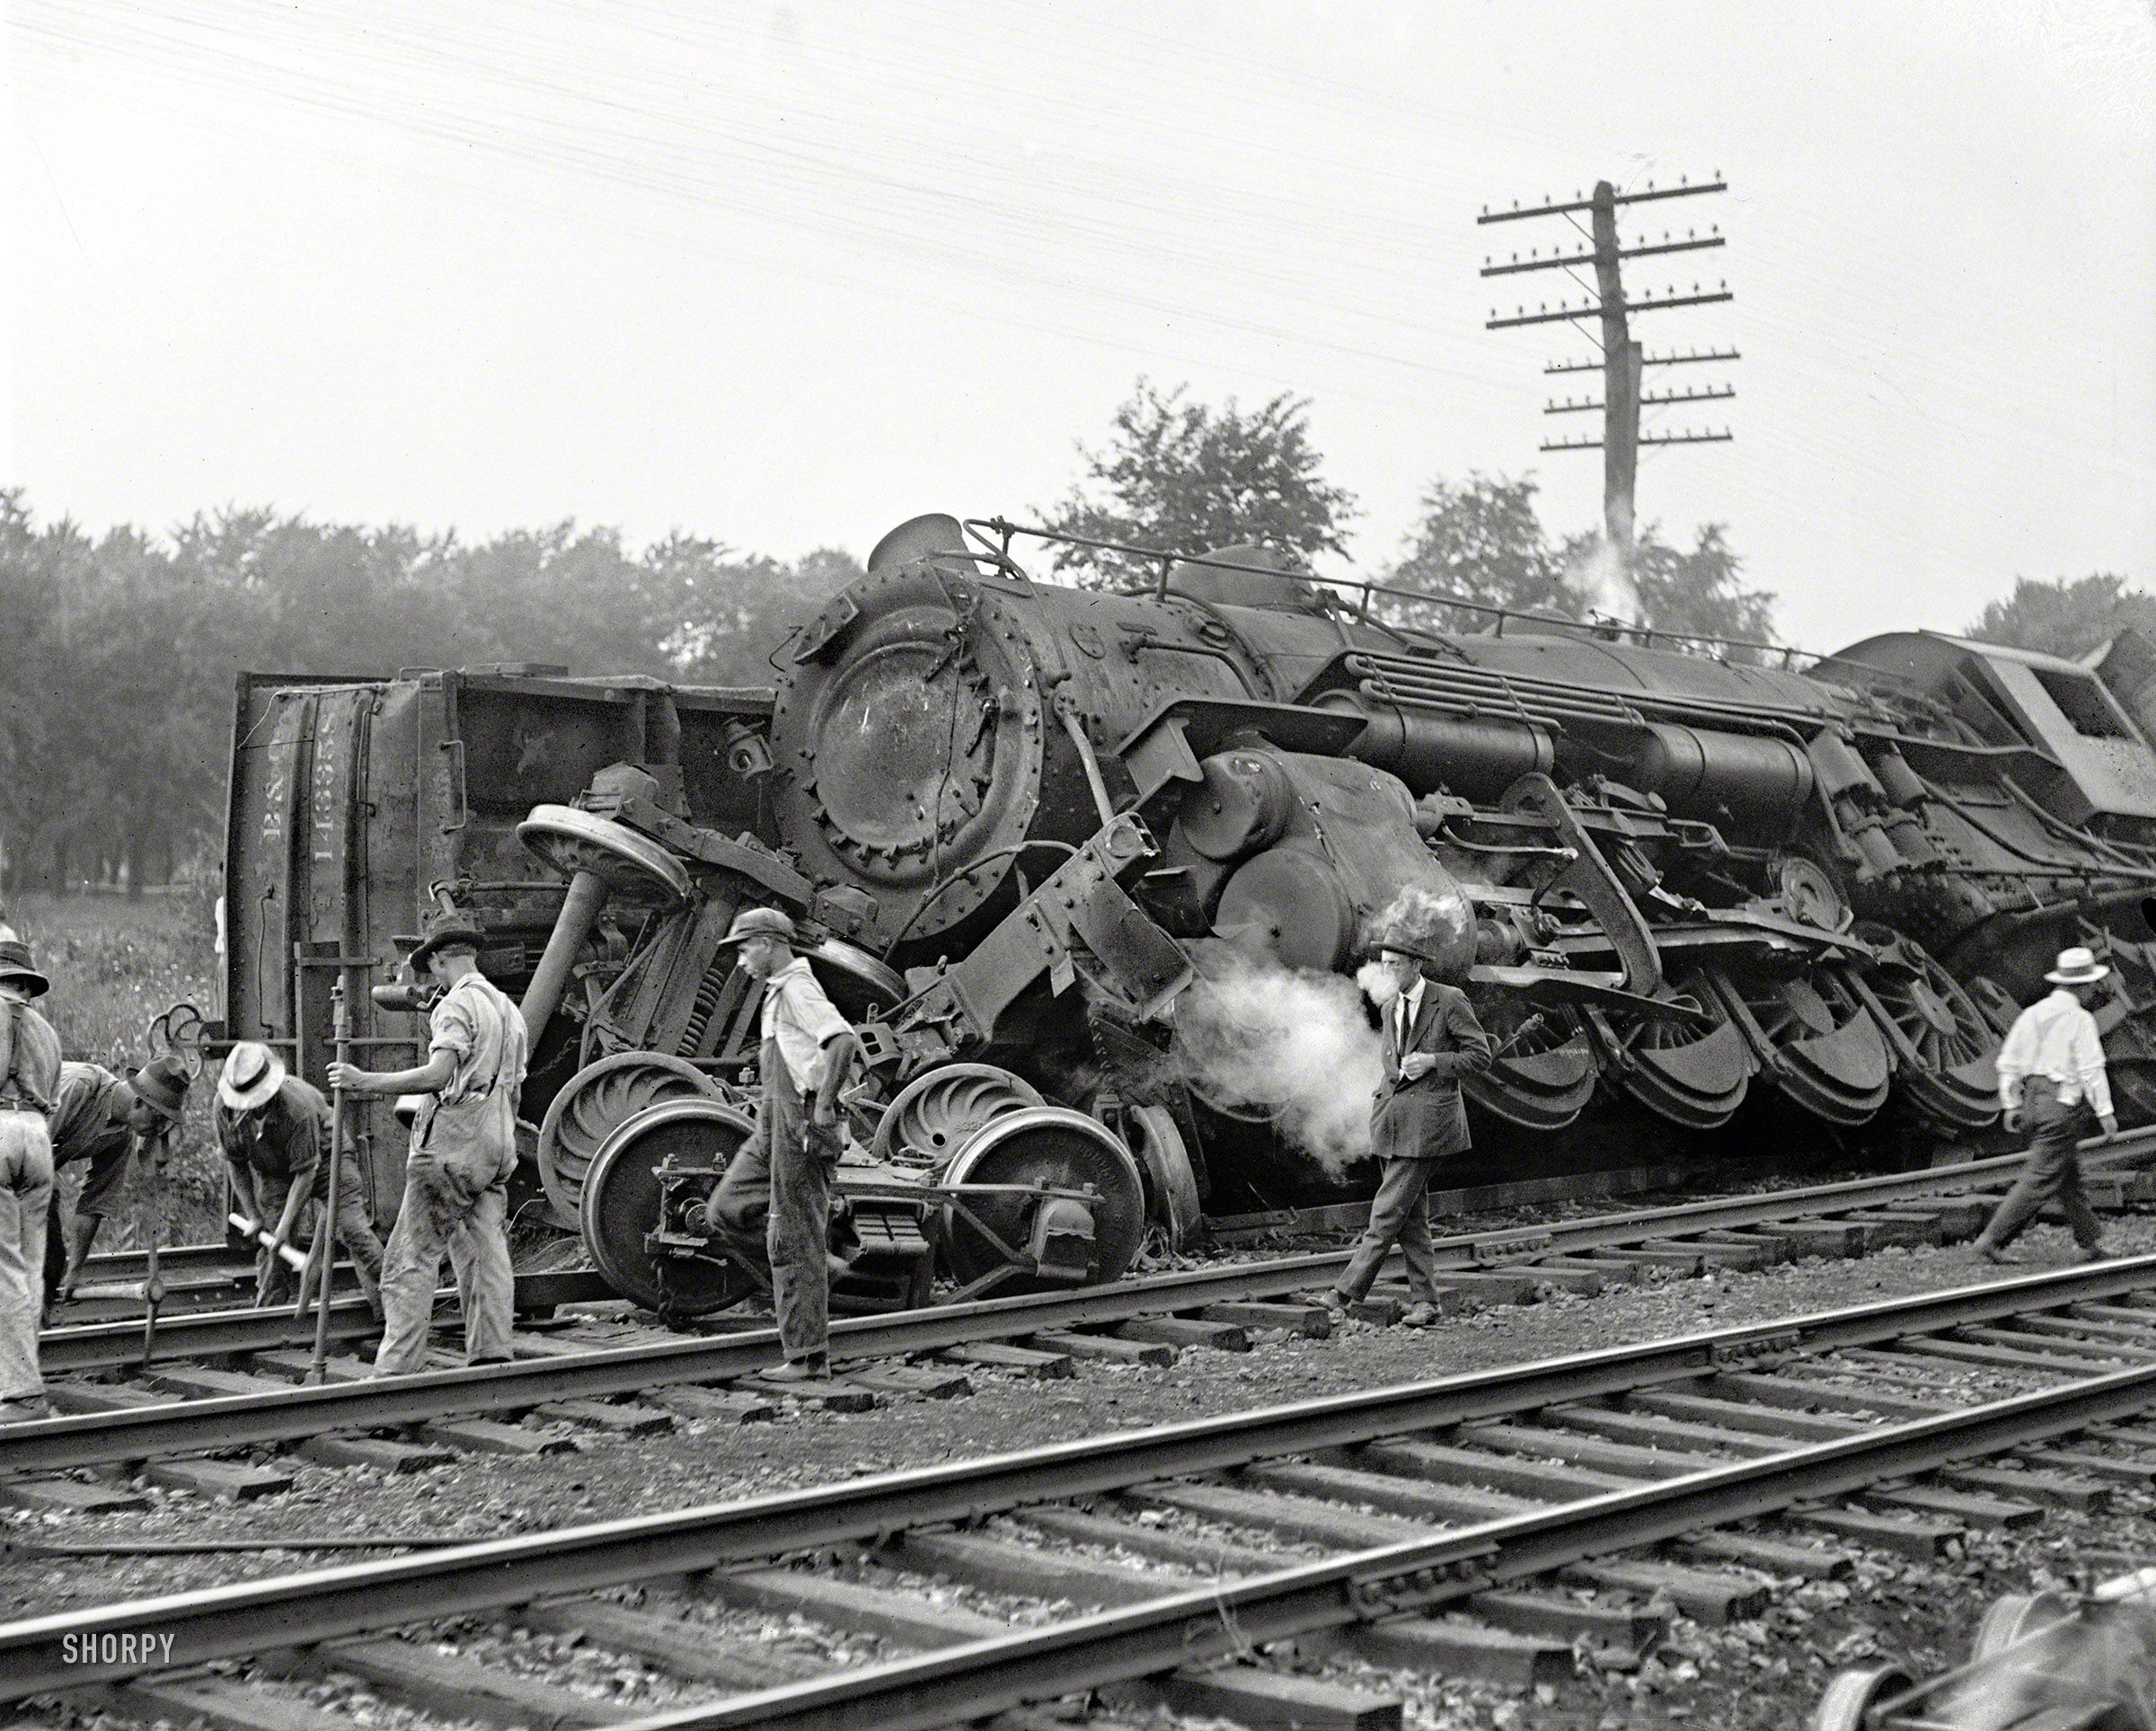
AVOIDING RISKS
Notes:
From https://nl.pinterest.com/pin/264868021811453901/

Slide 14
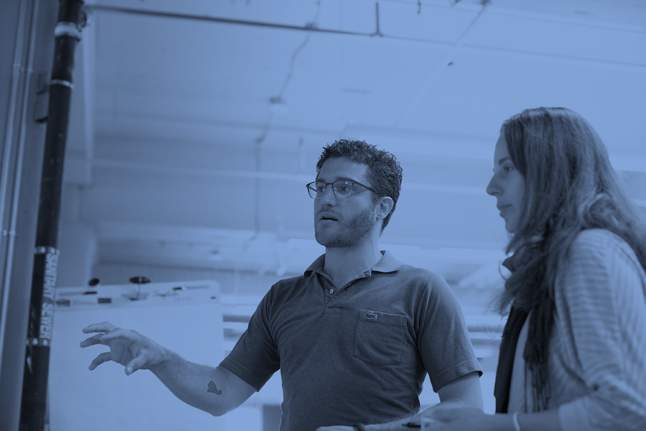
Intro to Risks
What could keep us from accomplishing the goals?
Competition; just another Twitter feature
Too big of scope for current timeline and/or team size
External dependencies; other teams, integrations (single sign-on)
Especially those that have not been built yet or dependent on other teams to build
Choice of technologies; immature language, framework, etc
Existing technical debt; no tests
Federal regulations; PCI compliance

Slide 15
Why are identifying risks are important?
Why should I care about risks?
May push out timeline
May increase cost
May have unrealistic dependency; tools, teams, etc
Because we may prioritize our work based on our ability to mitigate risks!

Slide 16
High risk
Hard to mitigate
Easy to mitigate
Low risk

Slide 17
Risks Exercise
Write down 2-3 risks
+1 when you see a similar risk
Add any risks that you can identify to this shared document.

Slide 18
Tackling risks
How do we mitigate risks?
Increase budget
Increase timeline
Reduce scope and deliver high-value business value first
Reduce integrations
Tackle risky areas early
Create communication patterns to mitigate dependencies

Slide 19
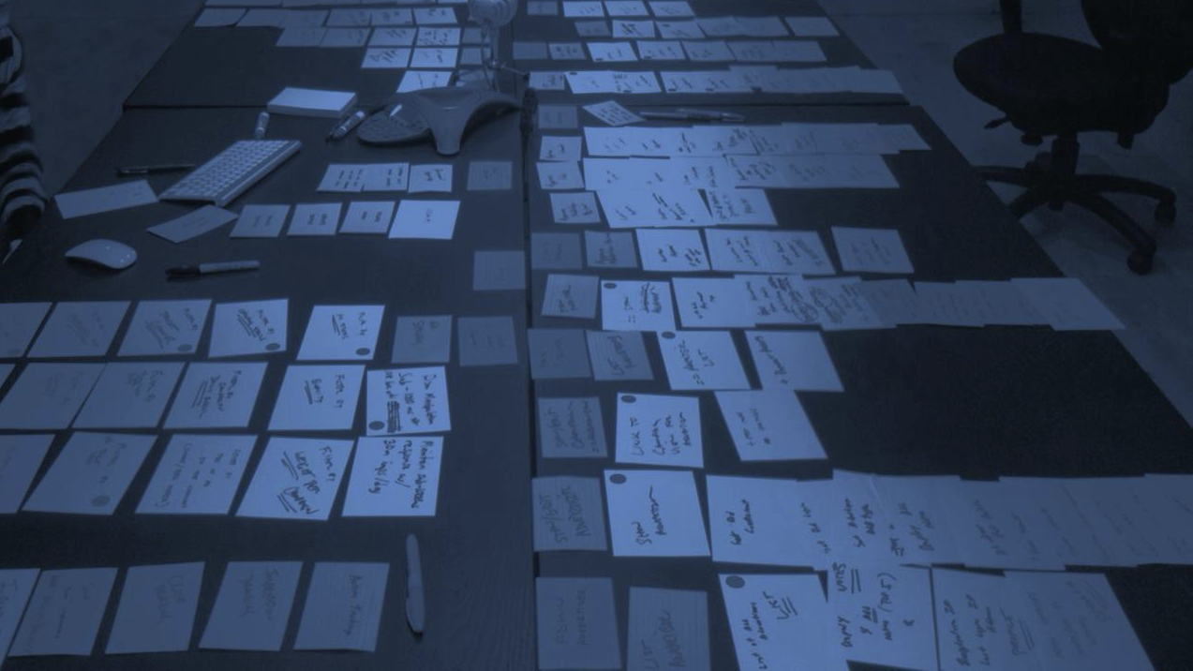
USER STORIES

Slide 20
User stories - lecture goals
Present an introduction to the topic of user stories
concepts and terminology
benefits and limitations
Present an introduction to iteration planning
Estimating User Stories
Planning a Release
Planning an Iteration
Measuring and Monitoring Velocity

Slide 21
Credit Where Credit is Due
This material is drawn from the below textbook -
“User Stories Applied” by Mike Cohn Publisher: Addison-Wesley/Pearson Education ISBN-13: 978-0-321-20568-1
It’s a great book for going in depth on the topic of user stories

Slide 22
User Stories
User stories are a means to capture requirements during the analysis phase of software development
whenever that phase occurs during your particular software life cycle
that said -- analysis can really happen at any time -- and it does in practice!!!
They are a lightweight mechanism for spreading decision making out across a software development project with respect to individual features
We know we need feature X but we don’t know much about it?
name it and put it in a user story
We learned a little bit more about feature X today?
add a short note to the user story (or even better, write a test)

Slide 23
Background (I)
The notion of a user story evolved because capturing software requirements is a communication problem
Those who want new software need to communicate what they need to those who will build it
Many stakeholders will provide input to the process
customers, users, and domain experts
business and marketing
developers

Slide 24
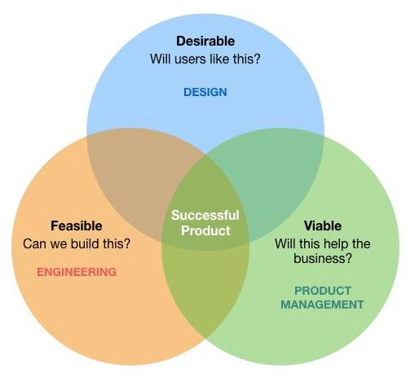
Background (II)
If any group dominates this discussion, the whole project suffers
if business dominates, it may mandate features and schedules with little regard to feasibility
if the developers dominate, a focus on technology may obscure business needs and the developers may miss - is it desirable and viable
Furthermore, the goal is to understand the user’s problem and ensure the software meets their needs
both business and developers will move on, the users have to live with the developed software day in and day out
Notes:
Gnip example

Slide 25
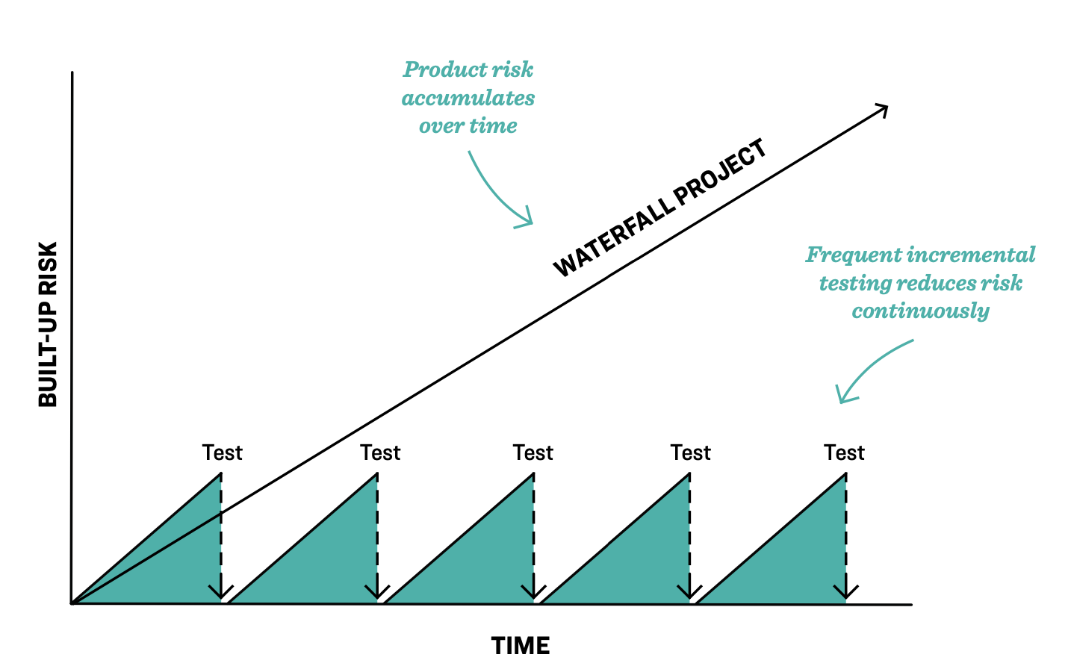
Background (III)
Furthermore, everything up front about the project is slightly impossible -
We still don’t understand exactly what the user needs
Their domain is complex; they are experts, we are novices
We’ll get things wrong and need to be corrected
We’ll get to a certain point and then they will remember things that they forgot to tell us
We’ll show them prototypes and they’ll come up with new ideas
We don’t have enough information to make accurate estimates
what we thought would be easy, turns out to be very complex

Slide 26
Background (IV)
And, so we have to make decisions based on the information we have
We set our scope small (one feature, for instance) and our development life cycle short (one week, for instance)
and then we show the customer what we have
By then, new information will be available and we’ll have feedback on the work we’ve done so far
With that input, we identify the new scope and start a new iteration
We thus spread out the decision making It’s not “everything up front” but “a little at a time”

Slide 27
User Stories: The Basics (I)
That’s where User stories come in; they describe functionality that will be valuable (desirable) to the user and/or customer
Note the distinction:
user: the people who actually use the produced software in their work
customer: a person—not necessarily a user—who is responsible for purchasing the software for a set of users
sometimes they are one and the same, but not always
Note also the use of the word “valuable” or “desirable”
We do NOT implement a feature because it is “cool”
we implement features to provide value to users

Slide 28
User Stories: The Basics (II)
User stories consist of
a short written description of a feature used for planning and a reminder (140 characters)
conversations about the feature used to flesh out its details
software tests that convey details about functionality and help us determine when the story is completely implemented
Ron Jeffries calls these three aspects Card, Conversation, and Confirmation
He says “card” because traditionally users stories are written on index cards and put up on a wall in the shared space of a development project
Using index cards forces you to keep the story brief!

Slide 29
User Stories: The Basics (III)
INVEST
Independent
Negotiable
Valuable
Estimable
Small
Testable
Example users stories for a website that helps a person’s job search
A user can post a resume to the website
A user can search for jobs
A company can post new job openings
Users can restrict access to their resume
Important:
User stories are written so that customers value them
This helps maintain a customer perspective within the development team

Slide 30
User Stories: The Basics (IV)
So, is this a good user story?
The software will make use of a bloom filter to determine if a desired data element is in our data set before we perform disk I/O to retrieve it

Slide 31
Not Really
Is your customer a distributed systems researcher?
Then, yes, maybe, this might be a good user story
But, in general, technical details like this do NOT make good user stories
These details may change
we need to switch from this framework to this other framework to be compatible on a wider range of devices
while the fundamental user story does not change
users need to access schedule information

Slide 32
How do we track details?
The users stories for an application can often be written simply at a high level of abstraction (known as epic user stories or epics for short); for example:
A user should be able to manage projects
But, you need to specify details at a lower level of abstraction
how do we do that?
A few places
in the conversations around a user story; we will converge on details
more users stories!

Slide 33
More users stories
You can take an epic like “A user should be able to manage projects” and split it into new stories (aka CRUD)
Create
Read (List, Show)
Update
Delete
On the epic, you note that it’s covered by these other stories and then you go work on those stories - the challenge: getting the balance right
We want to resist the temptation to document everything on a user story
Our conversations are the key element where details live (since the details WILL change while the user story remains the same)

Slide 34
Tests are integral to User Stories
At the start of a user story, the “tests” might exist as a set of customer expectations written on the back of a card
Try feature with an empty project description
Try feature with a really long project description
etc.
In this form, the tests can come and go as we learn more about the feature
As this particular user story is worked on and implemented
these expectations are transformed into unit tests and integration tests that tell us when the feature is completely implemented
we’re not done until all tests have passed!

Slide 35
Benefits
User stories provide the following benefits -
They emphasize verbal rather than written communication
Placeholder for a conversation!
They are comprehensible by customers and developers
They are the right size for planning
They encourage and “work” for iterative development
They encourage deferring details until you have the best understanding of what you really need to implement a feature

Slide 36
Stories Exercise
Let’s write some stories
As you listen add any stories that you can identify to this shared document.
Look for duplicates!

Slide 37
Questions?

Slide 38
User Stories
INVEST
Independent
Negotiable
Valuable
Estimable
Small
Testable

Slide 39
User Stories
Look for activities and actions
“Assign an owner” to a project
Add project owner
Remove project owner
“Assign contributors” to a project
Add user to project
Remove user from project

Slide 40
User Stories
Typical story flow -
Product owner creates work
Engineers, designers, etc start work
Engineers, designers, etc delivery work to a review environment
Product owner accepts or rejects the work
Story should be restarted
Product owner pushes to production environment

